Slide 1
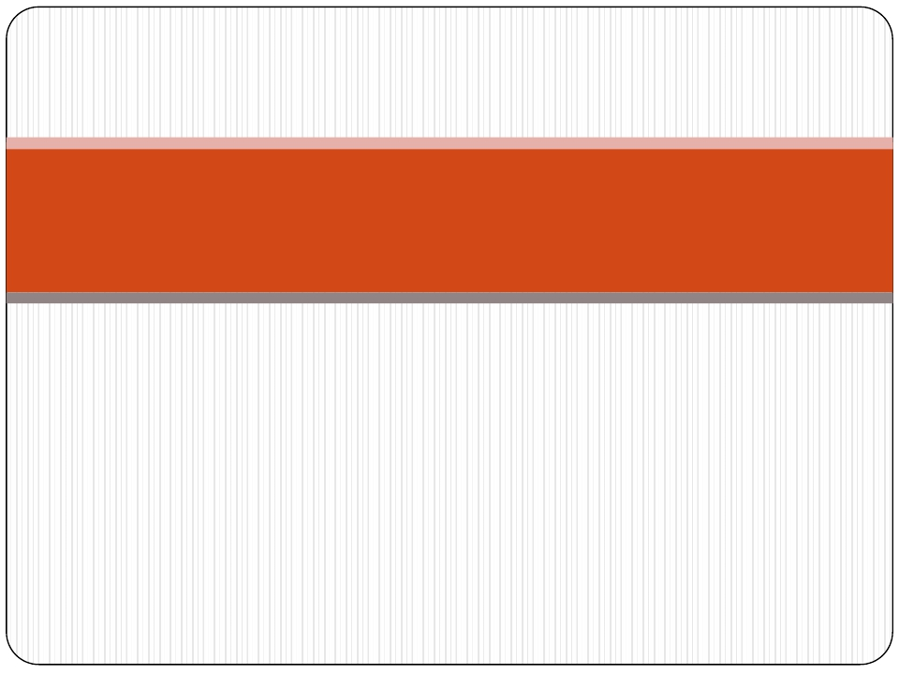
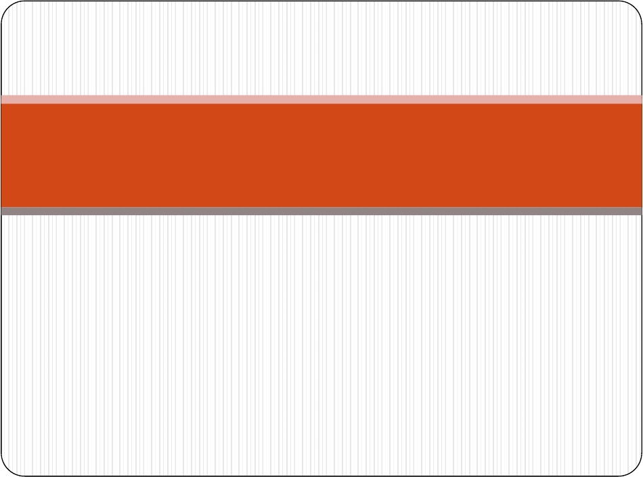
Shankersinh Vaghela Bapu Institute of Technology
(075)
Levelling & Contouring
Group members
THAKKAR NUPUR JATINKUMAR
HARSHVARDHAN SINH
SHAH KUSHAL CHANDRAKANT
Branch - Civil
Guide – Dorin Parmar

Slide 2
Definition, Principle, & Object of
Levelling
Definition:- Levelling is defined as“an art of
determining the relative height of different
points on,above or below the surface”.

Slide 3
Principle of levelling
Principle:-The principle of levelling is to obtain
horizontal line of sight with respect to which
vertical distances of the points above or below this
line of sight are found.

Slide 4
Object of levelling
The objective of levelling is to
1) Find the elevation of given point with
respect to some assumed reference line called
datum.
2)To establish point at required elevation
with respect to datum.

Slide 5
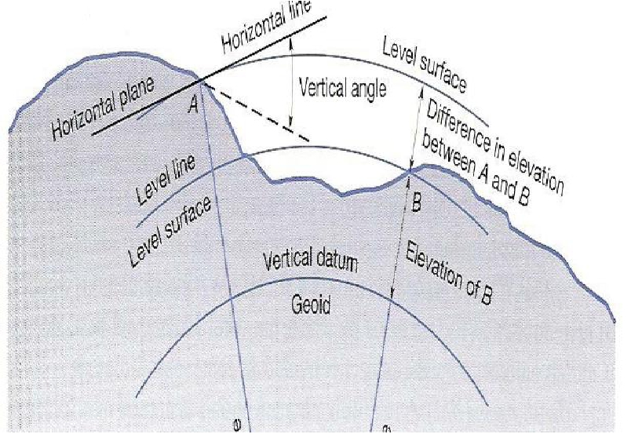

Slide 6
Definitions used in levelling
Level surface:- It is the surface parallel to the
mean spheroidal surface of the earth
Level line:- Line lying on level surface.
Horizontal plane:- Horizontal plane through a
point is a plane tangential to level surface.
Horizontal line:- It is a straight line tangential
to level line.

Slide 7
Datum:-“It is an arbitrary level surface from which
elevation of points may be referred”.In India mean sea level
is considered as datum of zero elevation it is situated at
Karachi.
Mean sea level is the average height of sea for all stages of
tides it is derived by averaging the hourly tide height over a
period of 19 years.
 Elevation or Reduced level:- It is height or depth of any
point above or below any datum.It is denoted as R.L.

Slide 8
Bench Mark (B.M.):- It is a fixed reference point of known
elevation with respect to datum.
Line of collimation:- It is a line joining the intersection of
cross hairs of diaphragm to the optical centre of object glass
and its continuation.It is also known as line of sight.
Height of instrument:- It is the elevation of line of
collimation with respect to datum
Back sight:- It is a staff reading taken at a known
elevation.It is the first staff reading taken after setup of
instrument.

Slide 9
Fore sight( F.S.):- It is the last staff reading taken denoting
the shifting of the instrument.
Intermediate sight.(I.S.):-It is staff reading taken on a
point whose elevation is to be determined.All staff reading
between B.S.and F.S.are Intermediate sight.
Change Point:- It is a point on which both fore and back
sight are taken.

Slide 10
Instruments for levelling
The following instruments are essentially required
for levelling
Level
Levelling staff

Slide 11
Level and types of level
Level:-The instrument used to furnish horizontal line
of sight for observing staff readings and determining
R.L.s
Types
Dumpy level
Tilting level
Wye level
Automatic level

Slide 12
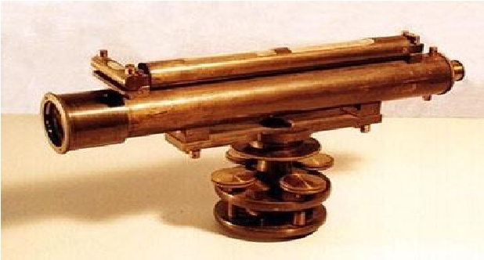
Dumpy level
The Dumpy level is a simple, compact and stable
instrument.The telescope is rigidly fixed to its supports.
Hence it cannot be rotated about horizontal axis.

Slide 13
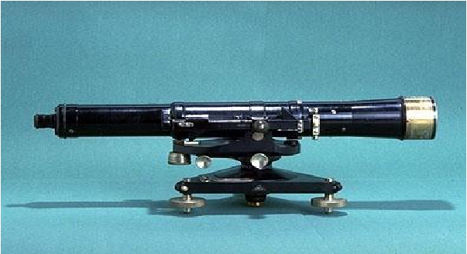
Tilting level
It is also known as I.O.P.level (Indian office Pattern).In
this level the telescope tilts about its horizontal axis
hence it is called tilting level

Slide 14
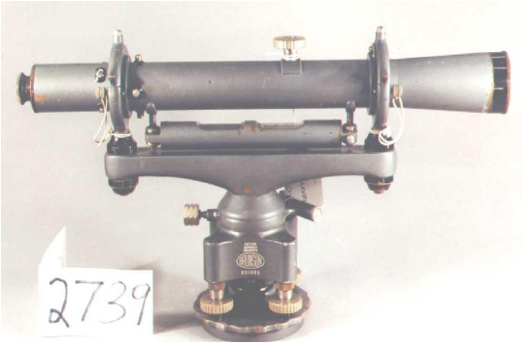
Wye level
 The essential difference between wye level and other levels is
that in wye level the telescope is carried by two vertical wye
supports. The telescope can be rotated,moved or even raised in
wyes.

Slide 15
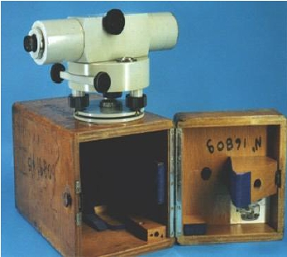
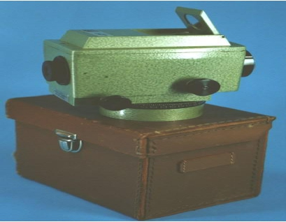
Automatic level
 It is also known as self aligning level.It is a recent development.
The fundamental difference between auto level and other levels
is that the levelling is not manually but it is levelled
automatically.It is achieved by inclination compensating device.

Slide 16
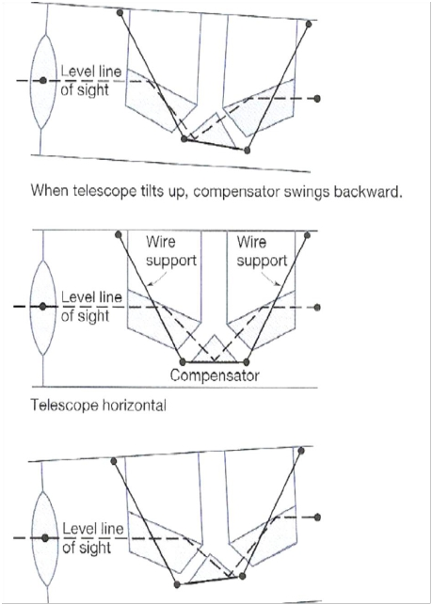

Slide 17
Levelling Staffs
Levelling staffs are scales on which these distances
are measured.
Levelling staffs are of two types
Self reading staff
Target staff

Slide 18
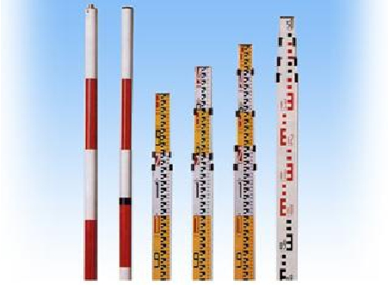
Self reading staff
The self reading staff can be read directly by the level
man looking through the telescope.
Common types of self reading staffs
Ordinary staff
Sopwith telescopic staff
Folding Staff

Slide 19
Target staff
For very precise works and sight target staff are used.A
movable target is provided in this staff.A vernier is
provided on target to give precise reading.In target staff
level man directs the staff man to move the target up
and down until it bisects by the line of sight.The staff
man observe the staff reading

Slide 20
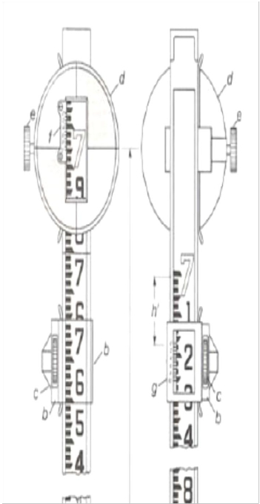

Slide 21
Bench Marks
Bench mark is a point of known elevation
There are 4 kinds of bench marks
GTS (Great trigonometrically survey bench mark)
Permanent bench mark
Arbitrary bench mark
Temporary bench mark

Slide 22
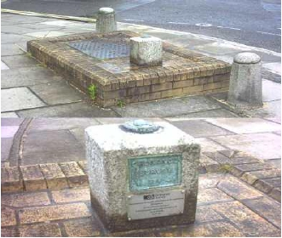
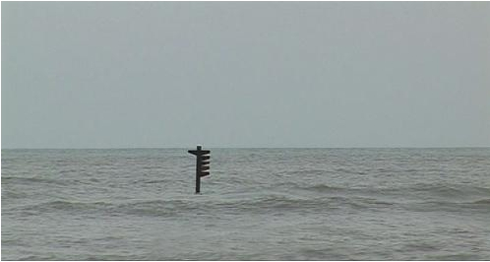
GTS Bench mark
 They are the bench marks established with very high degree of
precision at regular intervals by the survey of India Department
all over the countryTheir position and R.Ls values above mean
seal level at Karachi are given in catalogue formed by the
department.
 Mean sea level

Slide 23
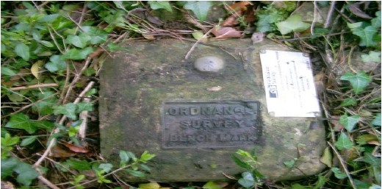
Permanent Bench mark
 Permanent bench marks are fixed in between GTS bench marks
by govt. agencies such as railways, PWD, etc. This bench marks
are written on permanent objects such as milestones, culverts,
bridges etc their value are clearly written and their position are
recorded for future reference.

Slide 24
Arbitrary bench marks:-These are reference points whose
R.L.s are arbitrarily assumed.They are used in small works
such bench mark may be assumed as 100.or 50 m
Temporary bench marks:- They are the reference points
established during the levelling operations when there is a
break in work,or at the end of day’s work the value of
reduced levels are marked on some permanent objects such
as stones,trees etc.

Slide 25
Temporary Adjustments of a level
These adjustments are performed at every setup of
instrument
Setting up of level
Levelling of telescope
Focusing of the eye peace
Focusing of object glass

Slide 26
 Setting up the level:-This includes
 A) Fixing the instrument on tripod
 B) Levelling the instrument approximately byTripod
 Levelling:- Levelling Levelling is done with the help of foot screws.
The purpose of levelling is to make vertical axis truly vertical.It is
done with the help of foot screws
 A) Place the telescope parallel to a pair of foot screw then hold the
foot screws between thumb and first finger and turn them either
inward or outward until the longitudinal bubble comes in the
centre.
 B)Turn the telescope through 900 so that it lies parallel to third foot
screw,turn the screw until the bubble comes in the centre.

Slide 27
Focusing the eye piece:-To focus the eye piece,hold a white
paper in front of object glass,and move the eye piece in or
out till the cross hair are distinctly seen.
Focusing of object glass:- Direct the telescope to the
levelling staff and on looking through the telescope,turn
the focusing screw till the image appears clear and sharp.

Slide 28
Classification of levelling
 Simple levelling
 Differential leveling
 Fly levelling
 Check levelling
 Profile levelling
 Cross levelling
 Reciprocal levelling
 Precise levelling
 Trignometric levelling
 Barometric levelling
 Hypersometric levelling

Slide 29
 Simple levelling:- It is the simplest method used,when it is
required to find the difference in elevation between 2 points.
 Differential Levelling:-This method is used to find the
difference in the elevation between points if they are too far
apart or the difference in elevation between them is too much.

Slide 30
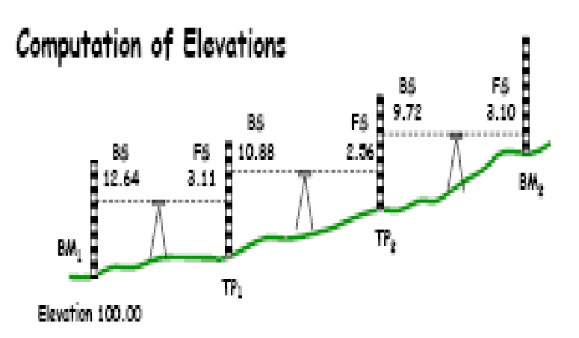

Slide 31
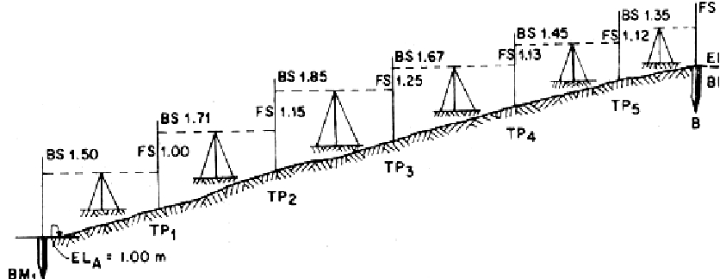
 Fly levelling:- Fly levelling is just like differential levelling
carried out to check the accuracy of levelling work.In fly
levelling only B.S.and F.S.are taken

Slide 32
Check levelling:-This kind of levelling is carried out to
check the accuracy of work.It is done at the end of the days
work in the form of fly levelling to connect the finishing
point and starting point.
Profile levelling or L-Section:-This method is used for
taking levels along the centre line of any alignment like
road,railway canal etc.The object is to determine the
undulations of the ground surface along the alignment

Slide 34
Cross- sectioning:-This operation is carried out
perpendicular to alignment at an interval of 10,20 ,30,
40 m.The idea is to make an estimate of earthwork.
Precise levelling:- It is used for establishing bench marks for
future public use.It is carried out with high degree of
accuracy using advanced instruments
Trignometric levelling:- In this method vertical distances
between points are computed by observing horizontal
distances and vertical angle between points.

Slide 35
Barometric levelling:- In this method the altitude difference
is determined by means of a barometer.
Hyposometric levelling:- The working of Hyposometry for
determining the elevation depends upon the fact that the
temperature at which water boils varies with the
atmospheric pressure.The boiling point of water reduces at
higher altitude thus knowing the boiling point of water,the
atmospheric pressure can be calculated and knowing the
atmospheric pressure altitude or elevation can be
determined

Slide 36
Reciprocal levelling
 Reciprocal levelling:-This method is adopted to accurately
determine the difference of level between two points which are far
apart.It is also used when it is not possible to set up level in mid way
between two points
 Let A and B be the two points on opposite banks of a river. It is
required to find out the level difference betweenA & B
 Set up the level very near to A and take the reading at A and B let
the reading be a1 and b1
 Shift the level and set up very near to B and observe A and B to get
reading a2 and b2
 Let d is the true difference of level between A and B, and e= error
due to curvature,refrection and imperfect adjustment.

Slide 37
 Thus to eliminate the error take an average of the difference in
elevation taken from 2 points
 i.e.fromA the true difference will be =(b1-e)-a1
 From B the difference will be= b2-(a2-e)
 Therefore d={(b1-a1)+ (b2-a2)}/2
b1’
(a2’
b1’ ‘
Line of collimation
level Line
b1’
e
b1
a1
A
B
River

Slide 38
 Thus to eliminate the error take an average of the difference in elevation
taken from 2 points
 i.e.fromA the true difference will be =(b1’-e)-a1
 From B the difference will be= b2-(a2’-e)
 Therefore d={(b1-a1)+ (b2-a2)}/2
Line of collimation
a2’
b2
e
level Line
a2
A
B
River

Slide 39
Methods of Reducing levels
Height of Instrument Method:-This method consist of
finding H.I.for every setup of instrument,and then
obtaining the R.L.of point of reference with respect to
H.I

Slide 40
HI
B.S 0.9m
B.M
100
M.
I.S
1.1m
F.S 1.05m B.S 1.45m
C 99.85 m
F.S=1.55 m
D 99.750m
A 100m
B 99.8m
C .P.
Station | B.S | I.S | F.S | H.I | R.L | Remark
A | 0.9 |  |  | 100.9 | 100.00 | B.M
B |  | 1.1 |  |  | 99.800
C | 1.450 |  | 1.05 | 101.3 | 99.850 | C.P.
D |  |  | 1.550 |  | 99.750

Slide 41
Rise and fall method
This method consist of determining the difference of
level between consecutive points by comparing each
point with immediate preceding point.

Slide 42
Rise And Fall Method
B.S 0.9m
B.M
100
M.
I.S 1.1m
B 99.8m
F.S 1.05m
B.S 1.45m
C 99.85 m
F.S=1.55 m
D 99.750 m
A 100m
C .P.
Station | B.S | I.S | F.S | Rise | Fall | R.L | Remark
A | 0.9 |  |  |  |  | 100.00 | B.M
B |  | 1.1 |  |  | 0.2 | 99.800
C | 1.450 |  | 1.05 | 0.05 |  | 99.850 | C.P.
D |  |  | 1.550 |  | 0.1 | 99.750

Slide 43
Example
 The following staff readings were observed successively with
a level the instrument is moved by third sixth and eighth
readings.
 :2.228 :1.606 :0.988 :2.090 :2.864 :1.262 0.602 :1.982
:1.044 :2.684 m enter the reading in record book and
calculate R.L.if the first reading was taken at a B.M of
432.383m

Slide 44
H.I. Method
Station | B.S | I.S | F.S | HI | RL | REMAR KS
1 | 2.228 |  |  | 434.612 | 432.384M | B.M.
2 |  | 1.606 |  |  | 433.006
3 | 2.090 |  | 0.988 | 435.714 | 433.624 | RD 3C.P.
4 |  | 2.864 |  |  | 432.850
5 | 0.602 |  | 1.262 | 435.054 | 434.452 | TH 6C.P
6 | 1.044 |  | 1.982 | 434.116 | 433.072 | TH 8C.P
7 |  |  | 2.684 |  | 431.432
 | 5.964 |  | 6.916
CHECK ∑ B.S- ∑ F.S= 5.964-6.916= -0.952 = LAST R.L- FIRST R.L= 431.432-432.384=-0.952

Slide 45
Rise and fall method
Station | B.S | I.S | F.S | Rise | Fall | RL | REMARKS
1 | 2.228 |  |  |  |  | 432.384M | B.M.
2 |  | 1.606 |  | 0.622 |  | 433.006
3 | 2.090 |  | 0.988 | 0.618 |  | 433.624 | RD 3C.P.
4 |  | 2.864 |  |  | 0.774 | 432.850
5 | 0.602 |  | 1.262 | 1.602 |  | 434.452 | TH 6C.P
6 | 1.044 |  | 1.982 |  | 1.38 | 433.072 | TH 8C.P
7 |  |  | 2.684 |  | 1.64 | 431.432
 | 5.964 |  | 6.916
CHECK ∑ B.S- ∑ F.S= 5.964-6.916= -0.952 =
LAST R.L- FIRST R.L= 431.432-432.384=-0.952
∑RISE- ∑ FALL= 2.842-3.794=-0.952

Slide 46
Contour
A contour is an imaginary line joining points of equal
elevation
120
100
105
110

Slide 47
Contour Interval
The vertical distance between any two consecutive
contours is known as contour interval
Contour interval

Slide 48
Characteristics of contour lines
 A series of contour lines with higher value inside
indicate a hill
 A series of contour lines with lower value inside the loop
always indicate depression
 Close contour lines indicate steep slope
 Wide contour lines indicate flatter slope
 Contour lines never cross each other except in case of
overhanging cliff.
 All points on a contour lines have equal elevation

Slide 49
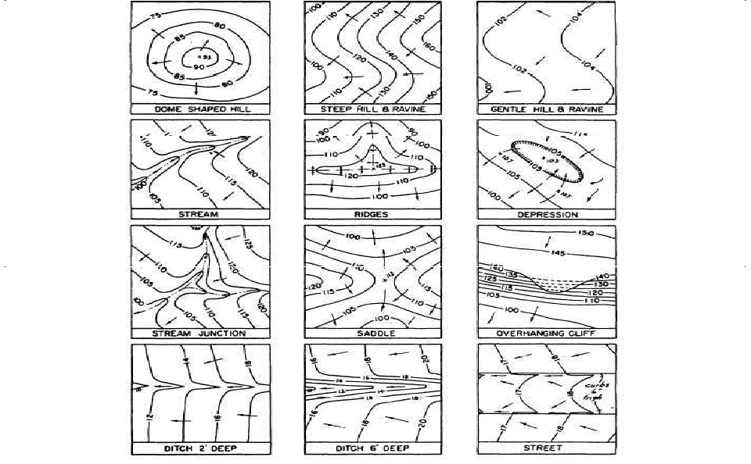

Slide 50
Uses of Contours
The nature of ground surface of a region can be known
Contour map helps in locating proper site for bridges,
dams,reservoirs etc.
Capacity of a reservoir can be calculated with the help
of contour map
The quantity of cutting and filling can be determined
from contour maps.
Routes for roads,railways,canals etc can be traced.

Slide 51
Errors in Levelling
 The following are the different sources of Errors
➢ Personal Error
➢ The Instruments may not be leveled
➢ The focusing of eye piece and objective glass may not be
perfect
➢
➢
➢
➢
The parallax may not be eliminated
The position of staff may have changed
Entry and recording in the field book may not be correct
The staff may not be fully extended,may not be held
vertical.

Slide 52
 Instrumental Error:
➢The Permanent adjustment of the instrument may
not be perfect. That is the line of collimation may
not be horizontal line
➢The internal arrangement of focusing tube may
not be correct
➢The graduation of the staff may not be perfect

Slide 53
 Errors due to Natural Causes:
➢The Curvature of the Earth may affect the staff
readings when the distance of sight is long.
➢The effect of refraction may cause a wrong staff
reading
➢There are some errors in staff readings due to
high velocity wind.

Slide 54
Curvature Correction
 For long sights the curvature of earth can effect staff
readings. The line of sight is horizontal but the level line is
curved and parallel to the mean spheroidal surface of the
earth.The vertical distance between the line of sight and level
line at particular place is called the curvature correction




The effect of curvature is to cause the object sighted to
appear lower than they really are.
Curvature correction is always Subtractive (-)
True staff reading= (Observed staff reading- 0.0785 D2) m
Where D= distance in Km.

Slide 55
Curvature Correction
(-)
Curvature
effect

Slide 56
Refraction
 The ray of light pass through layers of air of different
densities and refract or bent down. The effect of refraction is
to make the object appear higher then they really are.
Refraction varies considerably with climate conditions.




However it is taken as
Cr= 0.0112 D2 m (+)
Refraction is always additive
True staff reading= Observed staff reading + Refraction
correction.

Slide 57
Refraction
(+)
Refraction
effect

Slide 58
thanks

